Slide 1
CS 401 Artificial Intelligence
FAST-NU
Lecture 12
November 18, 2021
Department of Computer Science
National University of Computers & Emerging Sciences
Lahore.

Slide 2

Brief Review
An artificial neural network is an information processing system that has certain performance characteristics in common with biological neural networks.
An ANN can be characterized by:
  Architecture: The pattern of connections between different neurons.
  Training or Learning Algorithms: The method of determining weights on the connections.
  Activation Function: The nature of function used by a neuron to become activated.

Slide 3
Architecture
There are two basic categories:
Feed-forward Neural Networks
  These are the nets in which the signals flow from the input units to the output units, in a forward direction.
  They are further classified as:
    Single Layer Nets
    Multi-layer Nets
Recurrent Neural Networks
  These are the nets in which the signals can flow in both directions from the input to the output or vice versa.

Slide 4


Model 1: A Single Layer Net
w₁₁
X₁
Y₁
w₂₁
w₃₁
w₁₂
X₂
Y₂
w₂₂
●
●
●
w₃₂
●
●
●
X_{n}
w₁₃
Y_{m}
w_{2m}
Biological
Neurons
In Action
w_{nm}
Input
Units
Output
Units

Slide 5

Model 2: A Multi-Layer Net
X₁
w₁₁
v₁₁
Y₁
w_{i1}
Z₁
v_{j1}
●
●
●
w_{n1}
v_{p1}
●
●
●
●
●
●
w_{1j}
v_{1k}
X_{i}
Z_{j}
Y_{k}
w_{ij}
v_{jk}
w_{nj}
●
●
●
v_{pk}
Biological
Neurons
In Action
●
●
●
●
●
●
w_{1p}
v_{1m}
Z_{p}
X_{n}
w_{ip}
v_{jm}
Y_{m}
w_{np}
v_{pm}
Input
Units
Hidden
Units
Output
Units

Slide 6
Model 3: A Recurrent Net
1
w₁₁
1
X₁
Y₁
w_{1n}
v_{1n}
v_{1m}
w_{1m}
Biological
Neurons
In Action
X_{n}
Y_{m}
w_{nm}
1
1

Slide 7

Training
Supervised Training
Training is accomplished by presenting a sequence of training vectors or patterns, each with an associated target output vector.
The weights are then adjusted according to a learning algorithm.
During training, the network develops an associative memory. It can then recall a stored pattern when it is given an input vector that is sufficiently similar to a vector it has learned.
Unsupervised Training
A sequence of input vectors is provided, but no target vectors are specified in this case.
The net modifies its weights and biases, so that the most similar input vectors are assigned to the same output unit.

Slide 8
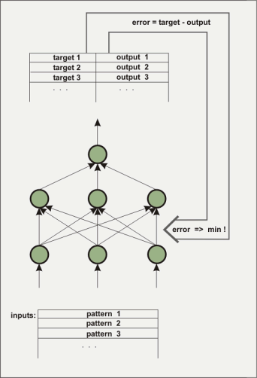
Supervised Learning
Each element in a training set is paired with an acceptable response
Network makes successive passes through the examples
The weights adjust toward the goal state.

Slide 9
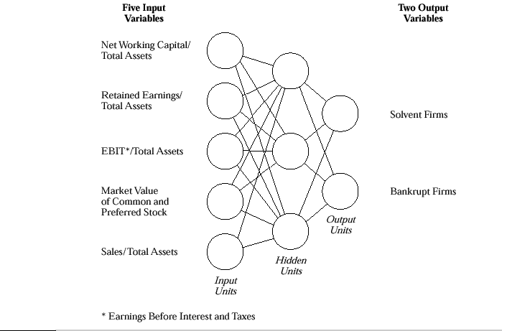
A Supervised Neural Network (An Example)

Slide 10
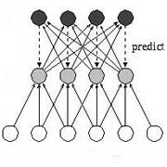
Unsupervised Learning
No external factors can influence adjustment of input’s weights
No advanced indication of correct or incorrect answers
Adjusts through direct confrontation with new experiences

Slide 11
Business Applications (1)
Risk management
  Appraise commercial loan applications
  NN trained on thousands of applications, half of which were approved and the other half rejected by the bank’s loan officers
  Through supervised learning, NN learned to pick risks that constitute a bad loan
  Identifies loan applicants who are likely to default on their payments

Slide 12
Business Applications (2)
Predicting Foreign Exchange Fluctuations:
  A set of relevant indicators were identified, used as inputs to NN
  NN was trained for exchange rates of US dollar against Swiss franc and Japanese yen, using data from first 6 months of 1990. Then it was tested over an 8- to 11-week period
  Results revealed return on capital of about 20%

Slide 13
Business Applications (3)
Mortgage Appraisals:
  Neural network uses the data in the mortgage loan application
  It estimates value of the property based on the immediate neighborhood, the city, and the country
  The system comes up with a valuation for the property and a risk analysis for the loan.

Slide 14
Reading Assignment & References
1. Section 10.1.1, 10.2.1 and 10.2.2 of George F.
Luger
2. Chapter 4 page 81-124, Machine Learning by
Tom M. Mitchell
3. Study the system ALVINN in detail.
http://www-2.cs.cmu.edu/afs/cs/project/ai-repository/
ai/areas/neural/systems/nevprop/np.c

